Slide 1


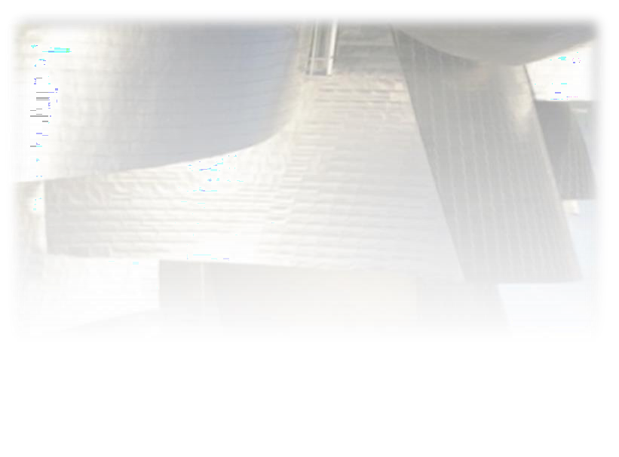
+
William Stallings Computer Organization and Architecture
10th Edition
© 2016 Pearson Education, Inc., Hoboken,
NJ. All rights reserved.

Slide 2
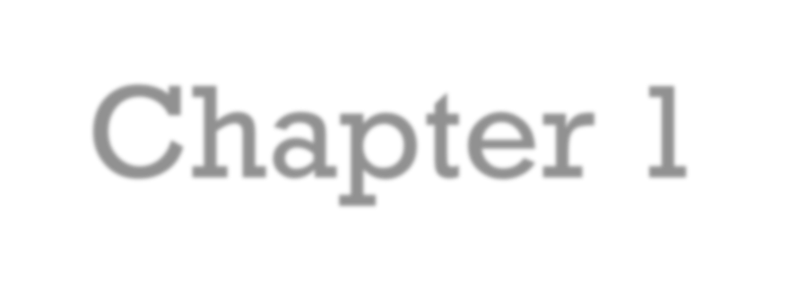
Chapter 1
+
Basic Concepts and Computer Evolution
© 2016 Pearson Education, Inc., Hoboken, NJ. All rights reserved.

Slide 3

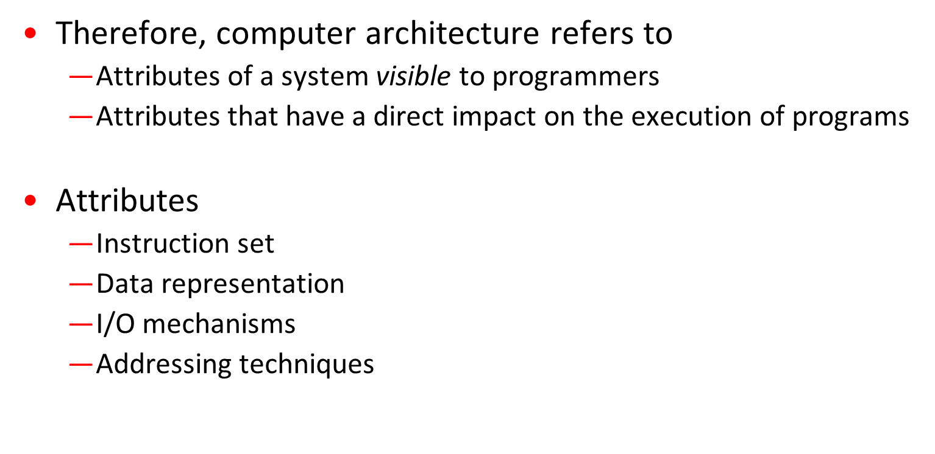

Slide 4
Computer Organization
Organization refers to operational units and their interconnections that realize the architectural specifications.
Attributes: hardware details transparent to programmers
  Control signals
  Computer/peripheral interface
  Memory technology

Slide 5




























Computer Architecture
Computer Organization
Instruction set, number of bits used to represent various data types, I/O mechanisms, techniques for addressing memory
Attributes of a system visible to the programmer
Have a direct impact on the logical execution of a program
Computer
Architecture
Architectural attributes include:
Organizational attributes include:
Computer
Organization
Hardware details transparent to the programmer, control signals, interfaces between the computer and peripherals, memory technology used
The operational units and their interconnections that realize the architectural specifications
© 2016 Pearson Education, Inc., Hoboken, NJ. All rights reserved.

Slide 6
Architecture & Organization- Family Concept
Many computer manufacturers offer a family of computer models, all with same architecture but with differences in organization, i.e.
All Intel x86 family share the same basic architecture
The IBM System/370 family share the same basic architecture
Organization differs between different versions
These newer versions retained the same architecture so that customer’s software investment was protected

Slide 7


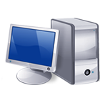
⁺ IBM System
370 Architecture
IBM System/370 architecture
  Was introduced in 1970
  Included a number of models
  Could upgrade to a more expensive, faster model without having to abandon original software
  New models are introduced with improved technology, but retain the same architecture so that the customer’s software investment is protected
  Architecture has survived to this day as the architecture of IBM’s mainframe product line
© 2016 Pearson Education, Inc., Hoboken, NJ. All rights reserved.

Slide 8
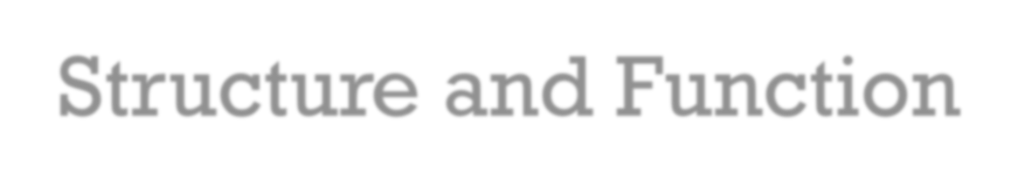
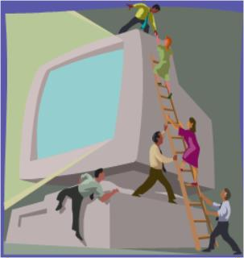
⁺ Structure and Function
A computer is a complex system; contemporary computers contain millions of Elementary electronic components. How, then, can one clearly describe them? The key is to recognize the hierarchical nature of most complex systems, including the computer
Hierarchical system
  Set of interrelated subsystems
Hierarchical nature of complex systems is essential to both their design and their description
Designer need only deal with a particular level of the system at a time
  Concerned with structure and function at each level
Structure
  The way in which components relate to each other
Function
  The operation of individual components as part of the structure

Slide 9
⁺ Function
There are four basic functions that a computer can perform:
  Data processing
    Data may take a wide variety of forms and the range of processing requirements is broad
  Data storage
    Short-term
    Long-term
  Data movement
    Input-output (I/O) - when data are received from or delivered to a device (peripheral) that is directly connected to the computer
    Data communications – when data are moved over longer distances, to or from a remote device
  Control
    A control unit manages the computer’s resources and orchestrates the performance of its functional parts in response to instructions

Slide 10
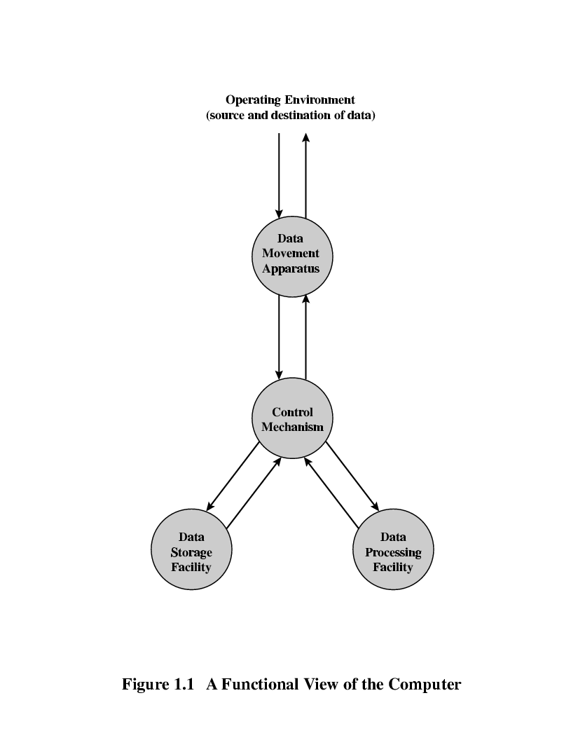
A Functional view of the Computer
The computer system must be able to process data, store data and move data b/w itself and the outside world.
A control unit manages the computer’s resources and performance of its functional parts in response to some instructions.
This figure depicts the four possible types of operations.
Notes:
10

Slide 11
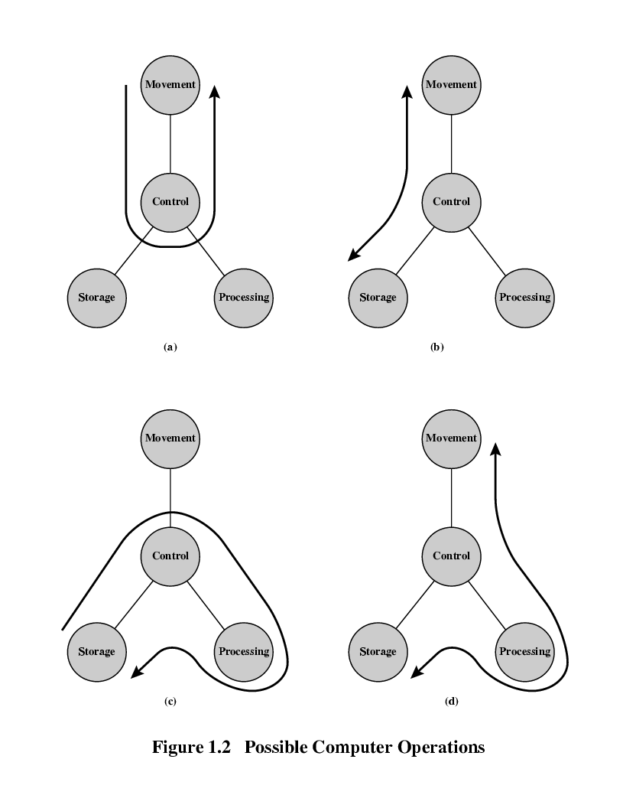
Operations (1) Data movement
The number of possible operations that can be performed …
(1)
The computer can function as a data movement device, simply transferring data from one peripheral or communication line to another.
  e.g. keyboard to screen
Notes:
11

Slide 12
Operations (2) Storage
(2)
The computer can function as a data storage device, with data transferred from the external environment to computer storage for read/write purpose.
  e.g. Internet download to disk
Notes:
12

Slide 13
Operation (3) Processing from/to storage
(3)
This diagram show operations involving data processing, on the storage data.
  e.g. updating bank statement
Notes:
13

Slide 14
Operation (4)
Processing from storage to I/O
(4)
This diagram show operations involving data processing, on data route b/w storage and the external environment.
  e.g. printing a bank statement
Notes:
14

Slide 15
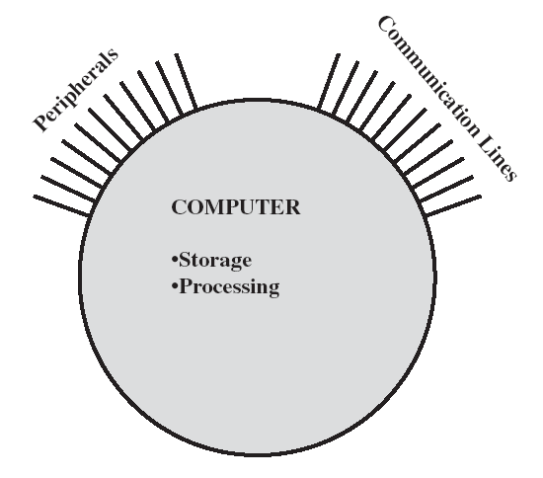
Computer Structure - Top Level
There are four main structural components:
Central Processing Unit (CPU): Controls the operation of the computer and performs its data processing functions; often simply referred to as PROCESSOR
Main Memory: Stores data
I/O: Moves data b/w the computer and its external environment
System Interconnection: Some mechanism that provides for communication among CPU, main memory, and I/O.
Notes:
15

Slide 16
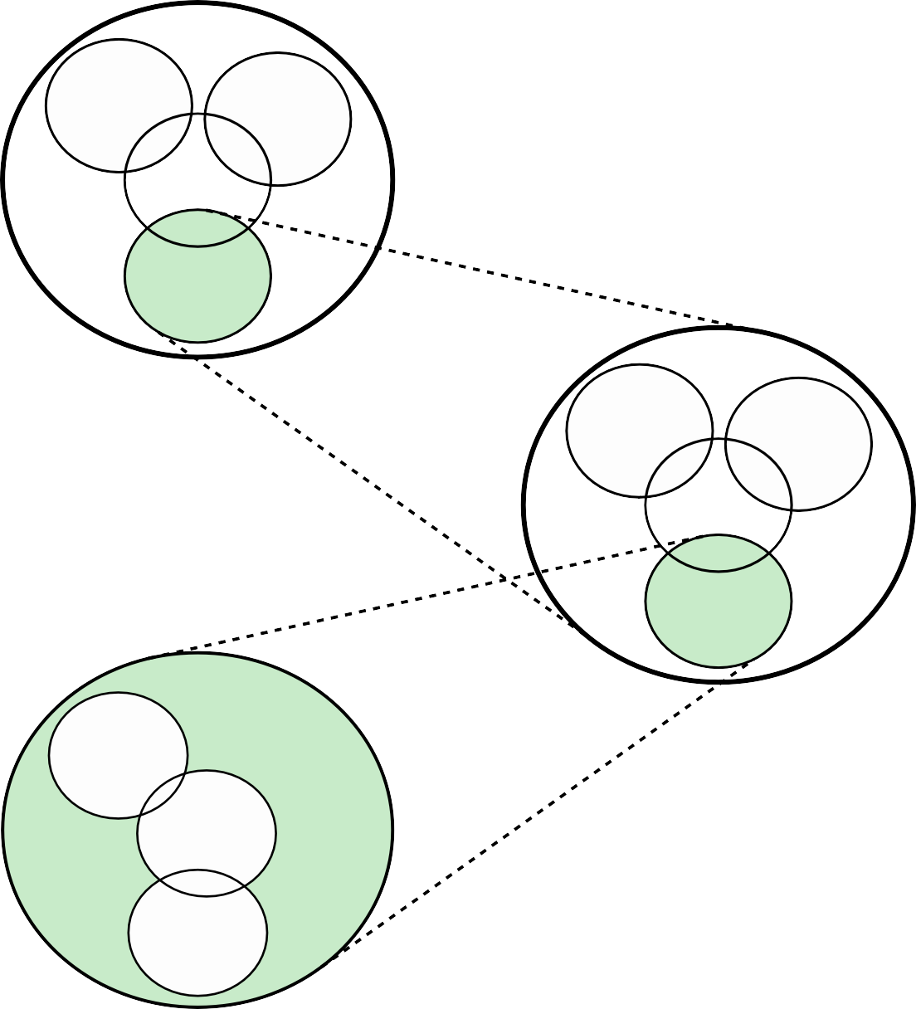

COMPUTER
I/O
Main memory
System Bus
CPU
CPU
Registers
ALU
Structure
Internal Bus
Control Unit
CONTROL UNIT
Sequencing Logic
Control Unit Registers and Decoders
Control Memory
Figure 1.1 A Top-Down View of a Computer

Slide 17
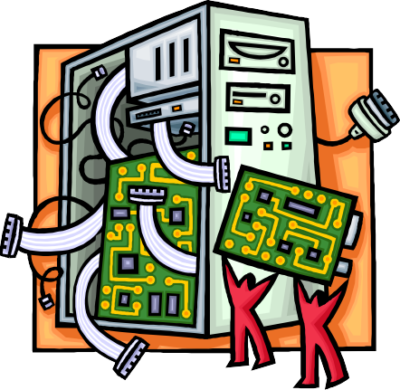
+
There are four main structural components
of the computer:
CPU – controls the operation of the computer and performs its data processing functions
Main Memory – stores data
I/O – moves data between the computer and its external environment
System Interconnection – some mechanism that provides for communication among CPU, main memory, and I/O
© 2016 Pearson Education, Inc., Hoboken, NJ. All rights reserved.

Slide 18
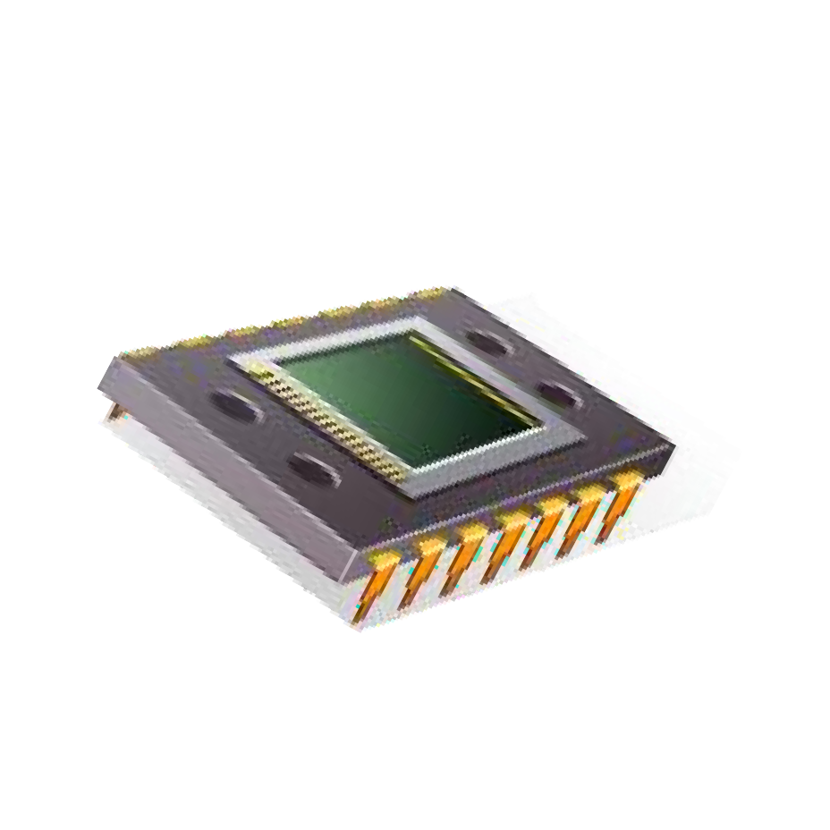
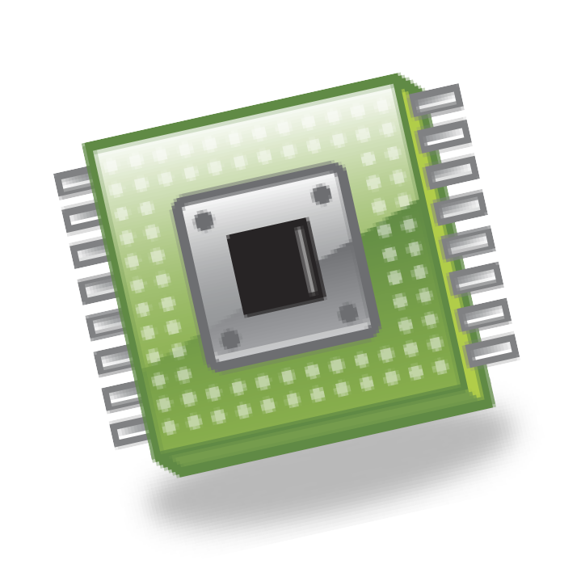
+
CPU
Control Unit
  Controls the operation of the CPU
and hence the computer
Major structural components:
Arithmetic and Logic Unit (ALU)
  Performs the computer’s data processing function
Registers
  Provide storage internal to the CPU
CPU Interconnection
  Some mechanism that provides for communication among the control unit, ALU, and registers
© 2016 Pearson Education, Inc., Hoboken, NJ. All rights reserved.

Slide 19
⁺ Multicore Computer Structure
Central processing unit (CPU)
  Portion of the computer that fetches and executes instructions
  Consists of an ALU, a control unit, and registers
  Referred to as a processor in a system with a single processing unit
Core
  An individual processing unit on a processor chip
  May be equivalent in functionality to a CPU on a single-CPU system
  Specialized processing units are also referred to as cores
Processor
  A physical piece of silicon containing one or more cores
  Is the computer component that interprets and executes instructions
  Referred to as a multicore processor if it contains multiple cores

Slide 20
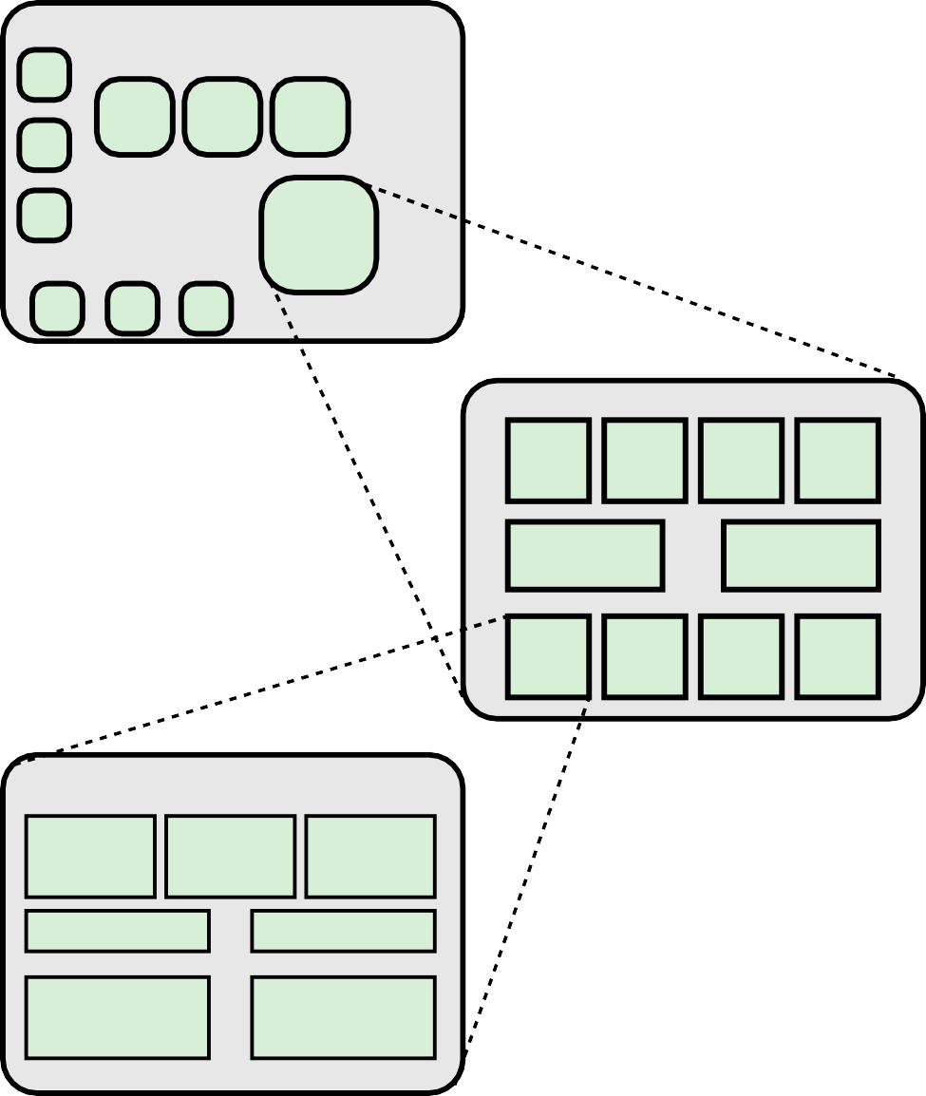
MOTHERBOARD
Main memory chips
Processor chip
I/O chips
PROCESSOR CHIP
Core Core Core
Core
L3 cache
L3 cache
Core
Core
Core
Core
CORE
Instruction logic
Arithmetic and logic unit (ALU)
Load/ store logic
L1 I-cache
L1 data cache
L2 instruction cache
L2 data cache
Figure 1.2 Simplified View of Major Elements of a Multicore Computer

Slide 21
⁺ Cache Memory
Multiple layers of memory between the processor and main memory
Is smaller and faster than main memory
Used to speed up memory access by placing in the cache data from main memory that is likely to be used in the near future
A greater performance improvement may be obtained by using multiple levels of cache, with level 1 (L1) closest to the core and additional levels (L2, L3, etc.) progressively farther from the core

Slide 22
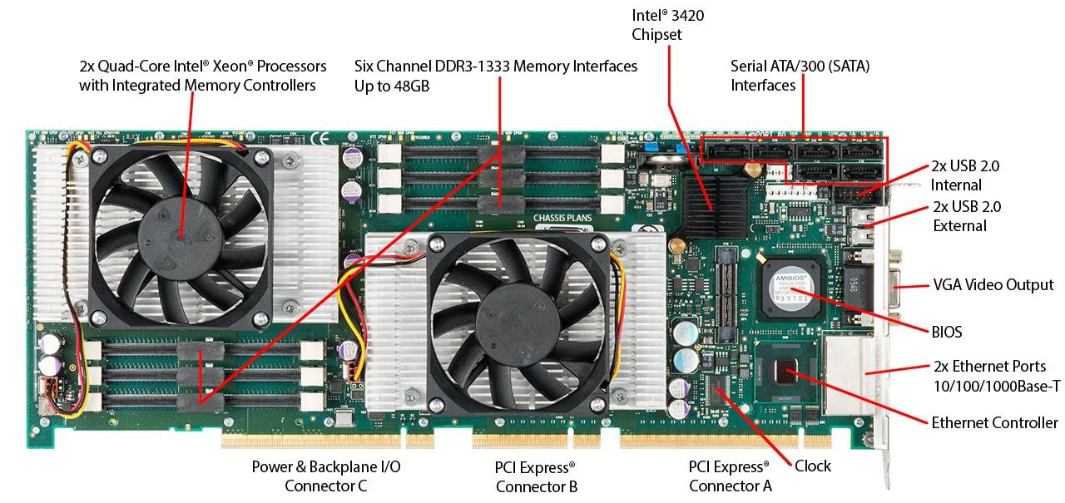
+
Figure 1.3
Motherboard with Two Intel Quad-Core Xeon Processors

Slide 23
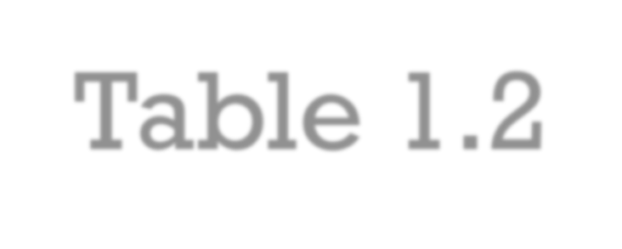

Table 1.2 Computer Generations
+
Generation | Approximate Dates | Technology | Typical Speed (operations per second)
1 | 1946–1957 | Vacuum tube | 40,000
2 | 1957–1964 | Transistor | 200,000
3 | 1965–1971 | Small and medium scale | 1,000,000
 |  | integration
4 | 1972–1977 | Large scale integration | 10,000,000
5 | 1978–1991 | Very large scale integration | 100,000,000
6 | 1991- | Ultra large scale integration | >1,000,000,000

Slide 24


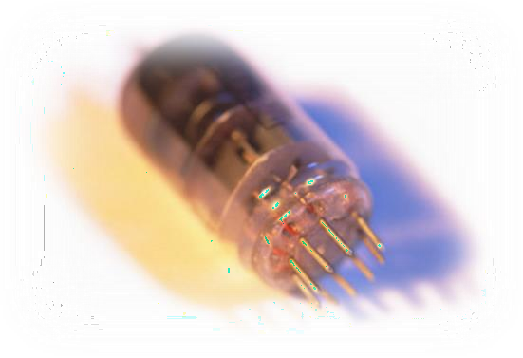
⁺ History of Computers
First Generation: Vacuum Tubes
Vacuum tubes were used for digital logic
elements and memory
IAS computer
  Fundamental design approach was the stored program concept
    Attributed to the mathematician John von Neumann
    First publication of the idea was in 1945 for the EDVAC
  Design began at the Princeton Institute for Advanced Studies (IAS)
  Completed in 1952
  Prototype of all subsequent general-purpose computers

Slide 25
0 1
39
sign bit
(a) Number word
left instruction (20 bits)
right instruction (20 bits)
0
8
20
28
39
opcode (8 bits)
address (12 bits)
opcode (8 bits)
address (12 bits)
(b) Instruction word
Figure 1.7 IAS Memory Formats

Slide 26





































Registers
+
Memory buffer register (MBR)
Contains a word to be stored in memory or sent to the I/O unit
Or is used to receive a word from memory or from the I/O unit
Memory address register (MAR)
Specifies the address in memory of the word to be written from or read into the MBR
Instruction register (IR)
Contains the 8-bit opcode instruction being executed
Instruction buffer register (IBR)
Employed to temporarily hold the right-hand instruction from a
word in memory
Program counter (PC)
Contains the address of the next instruction pair to be fetched
from memory
Accumulator (AC) and
multiplier quotient (MQ)
Employed to temporarily hold operands and results of ALU operations

Slide 27
Central processing unit (CPU)
Arithmetic-logic unit (CA)
AC
MQ
Arithmetic-logic circuits
Input-output equipment (I, O)
MBR
Instructions and data
Instructions and data
M(0)
M(1)
M(2)
M(3)
PC
IBR
M(4)
AC: Accumulator register MQ: multiply-quotient register MBR: memory buffer register IBR: instruction buffer register PC: program counter
MAR: memory address register IR: insruction register
MAR
IR
Main memory (M)
Control circuits
Control signals
M(4092)
M(4093)
Program control unit (CC)
M(4095)
Addresses
Figure 1.6 IAS Structure

Slide 28
Start
Yes
Is next instruction in IBR?
No
MAR PC
Fetch cycle
No memory access required
MBR M(MAR)
IR IBR (0:7)
MAR IBR (8:19)
IR MBR (20:27)
MAR MBR (28:39)
No
Left instruction required?
Yes
IBR MBR (20:39)
IR MBR (0:7)
MAR MBR (8:19)
PC PC + 1
Decode instruction in IR
AC
M(X)
Go to M(X, 0:19)
If AC > 0 then go to M(X, 0:19)
AC
AC + M(X)
Execution cycle
Yes
Is AC > 0?
MBR M(MAR)
PC MAR
No
MBR M(MAR)
AC MBR
AC AC + MBR
M(X) = contents of memory location whose addr ess is X (i:j) = bits i through j
Figure 1.8 Partial Flowchart of IAS Operation

Slide 29
Table 1.1
Instruction Type | Opcode | Symbolic Representation | Description
 | 00001010 | LOAD MQ | Transfer contents of register MQ to the accumulator AC
 | 00001001 | LOAD MQ,M(X) | Transfer contents of memory location X to MQ
Data transfer | 00100001 00000001 | STOR M(X) LOAD M(X) | Transfer contents of accumulator to memory location X Transfer M(X) to the accumulator
 | 00000010 | LOAD –M(X) | Transfer –M(X) to the accumulator
 | 00000011 | LOAD |M(X)| | Transfer absolute value of M(X) to the accumulator
 | 00000100 | LOAD –|M(X)| | Transfer –|M(X)| to the accumulator
Unconditional | 00001101 | JUMP M(X,0:19) | Take next instruction from left half of M(X)
branch | 00001110 | JUMP M(X,20:39) | Take next instruction from right half of M(X)
 | 00001111 | JUMP+ M(X,0:19) | If number in the accumulator is nonnegative, take next instruction from left half of M(X)
 |  | JU | If number in the
Conditional branch |  | MP + M(X ,20: 39) | accumulator is nonnegative, take next instruction from right half of M(X)
 | 00000101 | ADD M(X) | Add M(X) to AC; put the result in AC
 | 00000111 | ADD |M(X)| | Add |M(X)| to AC; put the result in AC
 | 00000110 | SUB M(X) | Subtract M(X) from AC; put the result in AC
 | 00001000 | SUB |M(X)| | Subtract |M(X)| from AC; put the remainder in AC
Arithmetic | 00001011 | MUL M(X) | Multiply M(X) by MQ; put most significant bits of result in AC, put least significant bits in MQ
 | 00001100 | DIV M(X) | Divide AC by M(X); put the quotient in MQ and the remainder in AC
 | 00010100 | LSH | Multiply accumulator by 2; i.e., shift left one bit position
 | 00010101 | RSH | Divide accumulator by 2; i.e., shift right one position
 | 00010010 | STOR M(X,8:19) | Replace left address field at M(X) by 12
Address modify | 00010011 | STOR M(X,28:39) | rightmost bits of AC Replace right address field at M(X) by 12 _{(Tab}
 |  |  | rightmost bits of AC
The IAS Instruction Set
The IAS computer had a total of 21 instructions
le can be found on page 17 in the textbook.)

Slide 30

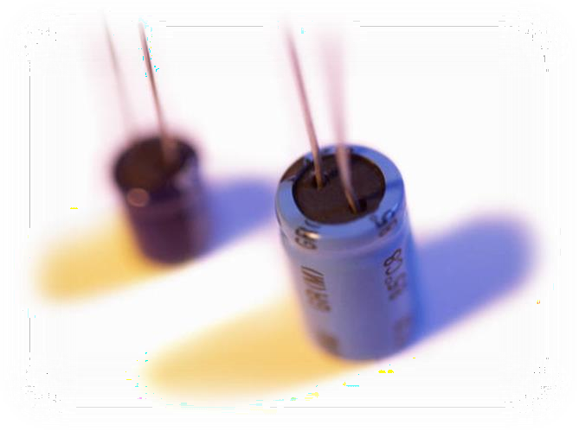
⁺ History of Computers
Second Generation: Transistors
Smaller
Cheaper
Dissipates less heat than a vacuum tube
Is a solid state device made from silicon
Was invented at Bell Labs in 1947
It was not until the late 1950’s that fully transistorized
computers were commercially available

Slide 31
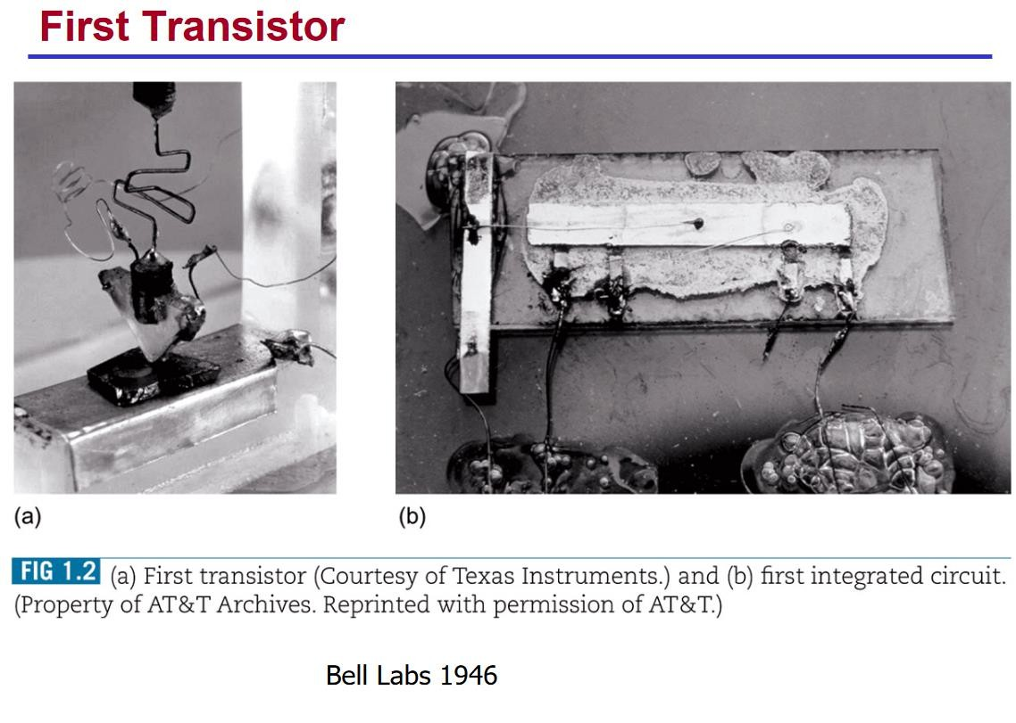
⁺ Transistor

Slide 32

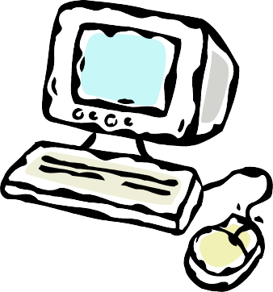
Second Generation Computers
+
Introduced:
  More complex arithmetic and logic units and control units
  The use of high-level programming languages
  Provision of system software which provided the ability to:
    Load programs
    Move data to peripherals
    Libraries perform common computations

Slide 33
IBM 7094 computer
Peripheral devices
Mag tape
units
CPU
Card punch
Data channel
Line printer
Card reader
Multi-plexor
Drum
Data channel
Disk
Data channel
Disk
Hyper-
tapes
Memory
Data channel
Teleprocessing
equipment
Figure 1.9 An IBM 7094 Configuration

Slide 34


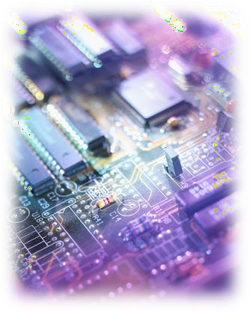
History of Computers
Third Generation: Integrated Circuits
1958 – the invention of the integrated circuit
Discrete component
  Single, self-contained transistor
  Manufactured separately, packaged in their own containers, and
soldered or wired together onto masonite-like circuit boards
  Manufacturing process was expensive and cumbersome
The two most important members of the third generation
were the IBM System/360 and the DEC PDP-8

Slide 35
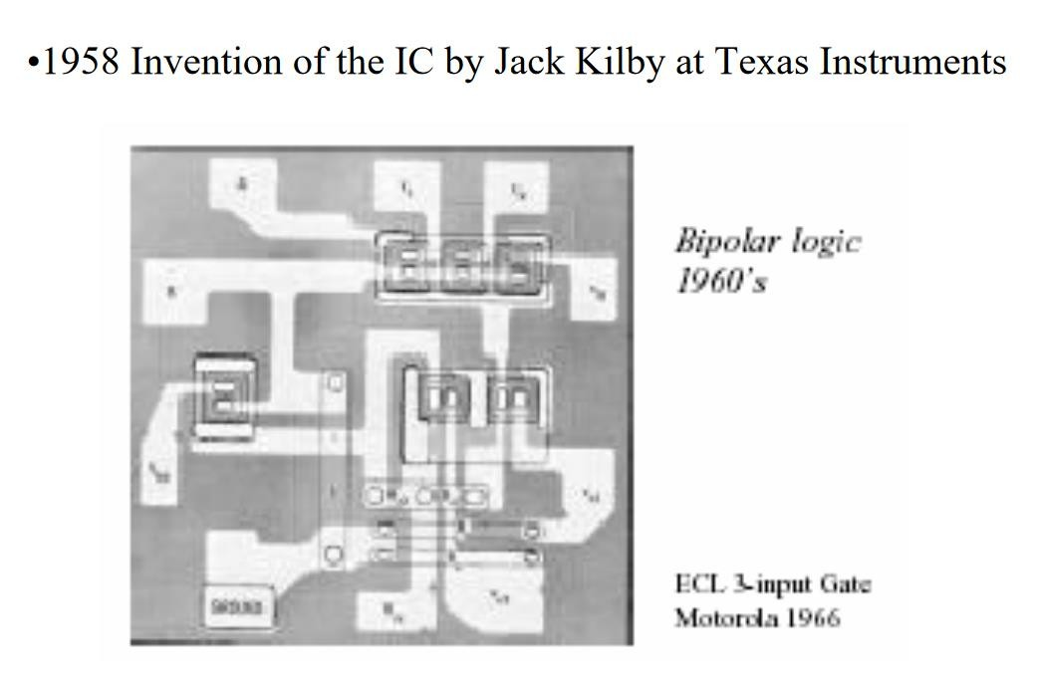
⁺ Integrated Circuit (IC)

Slide 36
Boolean logic function
Binary storage cell
Input
Output
Input
Output
Read Write
Activate signal
(a) Gate
(b) Memory cell
Figure 1.10 Fundamental Computer Elements

Slide 37


+
Integrated Circuits
Data storage – provided by
memory cells
A computer consists of gates, memory cells, and interconnections among these elements
The gates and memory cells are constructed of simple digital electronic components
Data processing – provided by gates
Exploits the fact that such components as transistors, resistors, and conductors can be fabricated from a semiconductor such as silicon
Data movement – the paths among components are used to move data from memory to memory and from memory through gates to memory
Many transistors can be produced at the same time on a single wafer of silicon
Control – the paths among components can carry control signals
Transistors can be connected with a processor metallization to form circuits

Slide 38
Wafer
Chip
Gate
Packaged chip
Figure 1.11 Relationship Among Wafer, Chip, and Gate

Slide 39
First working
integrated circuit
Invention of
Moore’s law
transistor
promulgated
100 bn
10 bn
1 bn
100 m
10 m
100,000
10.000
1,000
100
10
1
1947 50 55 60 65 70 75 80 85 90 95 2000 05
11
Figure 1.12 Growth in Transistor Count on Integrated Circuits (DRAM memory)

Slide 40
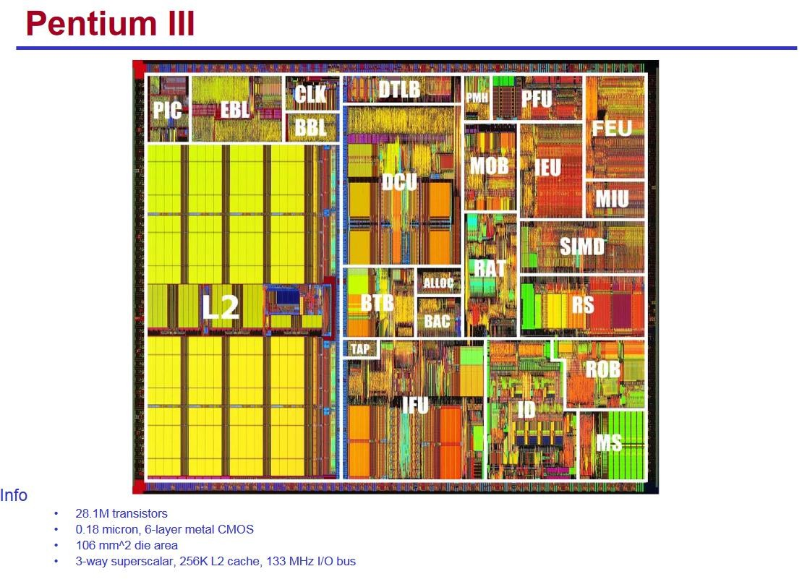

Slide 41
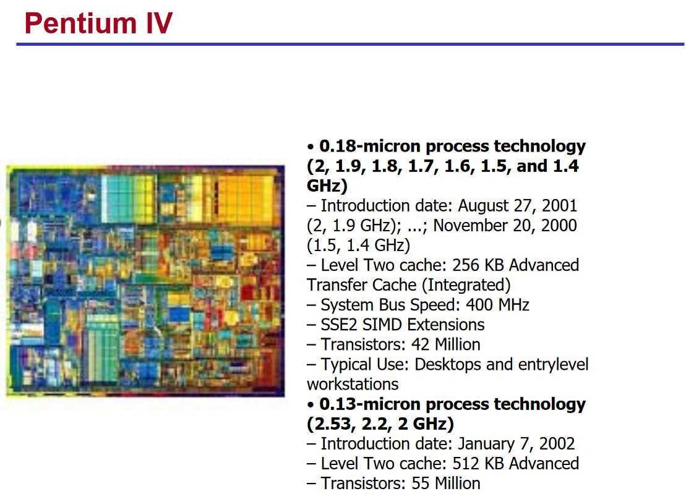

Slide 42



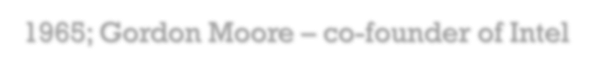







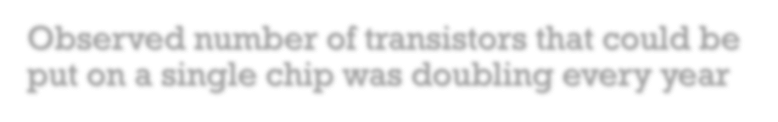




Moore’s Law
1965; Gordon Moore – co-founder of Intel
Observed number of transistors that could be put on a single chip was doubling every year
Consequences of Moore’s law:
The pace slowed to a doubling every 18 months in the 1970’s but has sustained that rate ever since
The cost of computer logic and memory circuitry has fallen at a dramatic rate
The electrical path length is shortened, increasing operating speed
Computer becomes smaller and is more convenient to use in a variety of environments
Reduction in power and cooling requirements
Fewer interchip connections

Slide 43
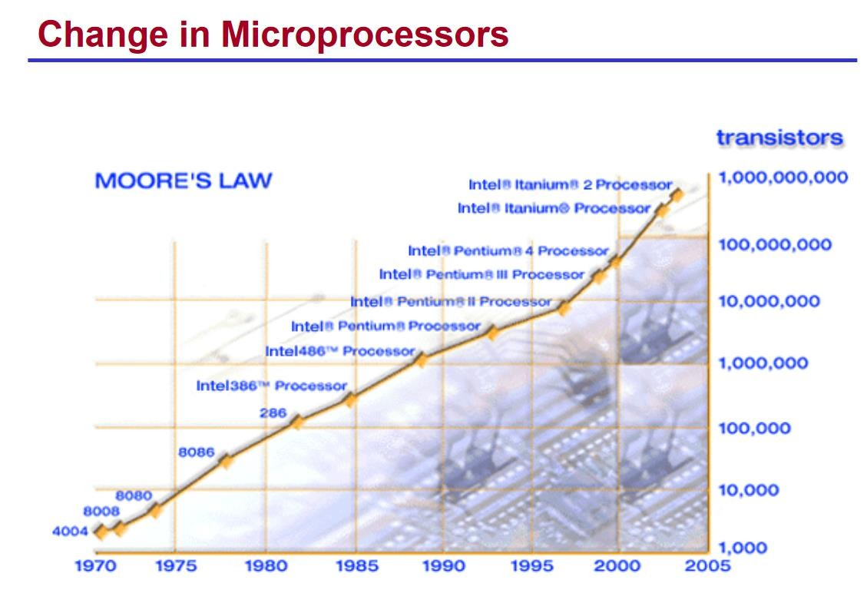

Slide 44
⁺ IBM System/360
Announced in 1964
Product line was incompatible with older IBM machines
Was the success of the decade and cemented IBM as the overwhelmingly dominant computer vendor
The architecture remains to this day the architecture of IBM’s mainframe computers
Was the industry’s first planned family of computers
  Models were compatible in the sense that a program written for one model should be capable of being executed by another model in the series

Slide 45
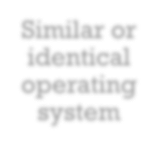





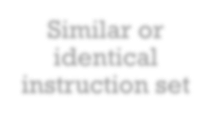
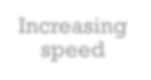





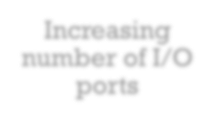
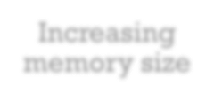

+ Family Characteristics
The concept of a family of compatible computers was both novel and extremely successful. A customer with modest requirements and a budget to match could start with the relatively inexpensive Model.
Similar or identical operating system
Similar or identical instruction set
Increasing speed
Increasing number of I/O ports
Increasing
memory size
Increasing cost

Slide 46
In the same year that IBM shipped its first System/360, another momentous first shipment occurred: PDP-8 from Digital Equipment Corporation(DEC).
At a time when the average computer required an air-conditioned room, the PDP-8. (dubbed a minicomputer by the industry, after the miniskirt of the day) was small enough that it could be placed on top of a lab bench or be built into other equipment. It could not do everything the mainframe could, but at
$16,000, it was cheap enough for each lab technician to have one. In contrast, the System/360 series of mainframe computers introduced just a few months before cost hundreds of thousands of dollars.
 | Console controller |  |  |  | CPU |  |  |  | Main memory |  |  |  | I/O module |  |  |  | I/O module
Omnibus
Figure 1.13
PDP-8 Bus Structure

Slide 47


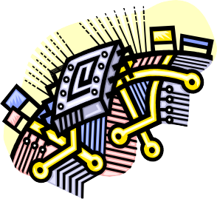
+
Later Generations
LSI
Large Scale Integration
VLSI
Very Large Scale Integration
ULSI
Ultra Large Scale Integration
Semiconductor Memory Microprocessors

Slide 48





Semiconductor Memory
In 1970 Fairchild produced the first relatively capacious semiconductor memory
Chip was about the size of a single core | Could hold 256 bits of memory | Non-destructive | Much faster than core
In 1974 the price per bit of semiconductor memory dropped below the price per bit of core memory
There has been a continuing and rapid decline in memory cost accompanied by a corresponding increase in physical memory density | Developments in memory and processor technologies changed the nature of computers in less than a decade
Since 1970 semiconductor memory has been through 13 generations
Each generation has provided four times the storage density of the previous generation, accompanied by declining cost per bit and declining access time

Slide 49

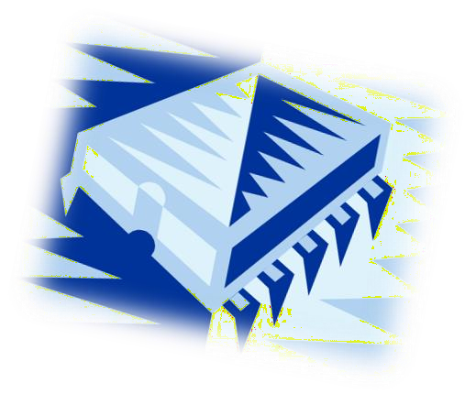
⁺ Microprocessors
The density of elements on processor chips continued to rise
  More and more elements were placed on each chip so that fewer and fewer chips were needed to construct a single computer processor
1971 Intel developed 4004
  First chip to contain all of the components of a CPU on a single chip
  Birth of microprocessor
1972 Intel developed 8008
  First 8-bit microprocessor
1974 Intel developed 8080
  First general purpose microprocessor
  Faster, has a richer instruction set, has a large addressing capability

Slide 50

Evolution of Intel Microprocessors
 | 4004 | 8008 | 8080 | 8086 | 8088
Introduced | 1971 | 1972 | 1974 | 1978 | 1979
Clock speeds | 108 kHz | 108 kHz | 2 MHz | 5 MHz, 8 MHz, 10 MHz | 5 MHz, 8 MHz
Bus width | 4 bits | 8 bits | 8 bits | 16 bits | 8 bits
Number of transistors | 2,300 | 3,500 | 6,000 | 29,000 | 29,000
Feature size (µm) | 10 | 8 | 6 | 3 | 6
Addressable memory | 640 Bytes | 16 KB | 64 KB | 1 MB | 1 MB
(a) 1970s Processors

Slide 51
Evolution of Intel Microprocessors
 | 80286 | 386TM DX | 386TM SX | 486TM DX CPU
Introduced | 1982 | 1985 | 1988 | 1989
Clock speeds | 6 MHz - 12.5 MHz | 16 MHz - 33 MHz | 16 MHz - 33 MHz | 25 MHz - 50 MHz
Bus width | 16 bits | 32 bits | 16 bits | 32 bits
Number of transistors | 134,000 | 275,000 | 275,000 | 1.2 million
Feature size (µm) | 1.5 | 1 | 1 | 0.8 - 1
Addressable memory | 16 MB | 4 GB | 16 MB | 4 GB
Virtual memory | 1 GB | 64 TB | 64 TB | 64 TB
Cache | — | — | — | 8 kB
(b) 1980s Processors

Slide 52
Evolution of Intel Microprocessors
 | 486TM SX | Pentium | Pentium Pro | Pentium II
Introduced | 1991 | 1993 | 1995 | 1997
Clock speeds | 16 MHz - 33 MHz | 60 MHz - 166 MHz, | 150 MHz - 200 MHz | 200 MHz - 300 MHz
Bus width | 32 bits | 32 bits | 64 bits | 64 bits
Number of transistors | 1.185 million | 3.1 million | 5.5 million | 7.5 million
Feature size (µm) | 1 | 0.8 | 0.6 | 0.35
Addressable memory | 4 GB | 4 GB | 64 GB | 64 GB
Virtual memory | 64 TB | 64 TB | 64 TB | 64 TB
Cache | 8 kB | 8 kB | 512 kB L1 and 1 MB L2 | 512 kB L2
(c) 1990s Processors

Slide 53
Evolution of Intel Microprocessors
 | Pentium III | Pentium 4 | Core 2 Duo | Core i7 EE 4960X
Introduced | 1999 | 2000 | 2006 | 2013
Clock speeds | 450 - 660 MHz | 1.3 - 1.8 GHz | 1.06 - 1.2 GHz | 4 GHz
Bus wid th | 64 bits | 64 bits | 64 bits | 64 bits
Number of transistors | 9.5 million | 42 million | 167 million | 1.86 billion
Feature size (nm) | 250 | 180 | 65 | 22
Addressable memory | 64 GB | 64 GB | 64 GB | 64 GB
Virtual memory | 64 TB | 64 TB | 64 TB | 64 TB
Cache | 512 kB L2 | 256 kB L2 | 2 MB L2 | 1.5 MB L2/15 MB L3
Number of cores | 1 | 1 | 2 | 6
(d) Recent Processors

Slide 54
⁺ The Evolution of the Intel x86 Architecture
Two common processor families are the Intel x86 and the ARM architectures
Current x86 offerings represent the results of decades of design effort on complex instruction set computers (CISCs)
An alternative approach to processor design is the reduced instruction set computer (RISC)
ARM architecture is used in a wide variety of embedded systems and is one of the most powerful and best-designed RISC-based systems on the market

Slide 55
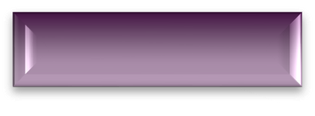
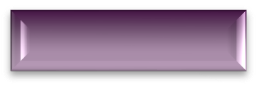
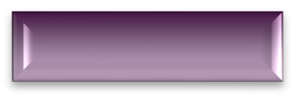



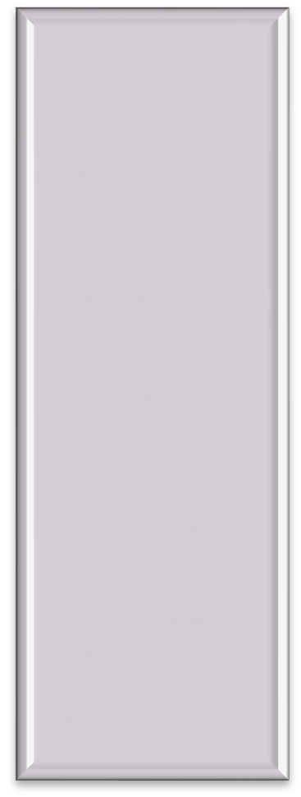
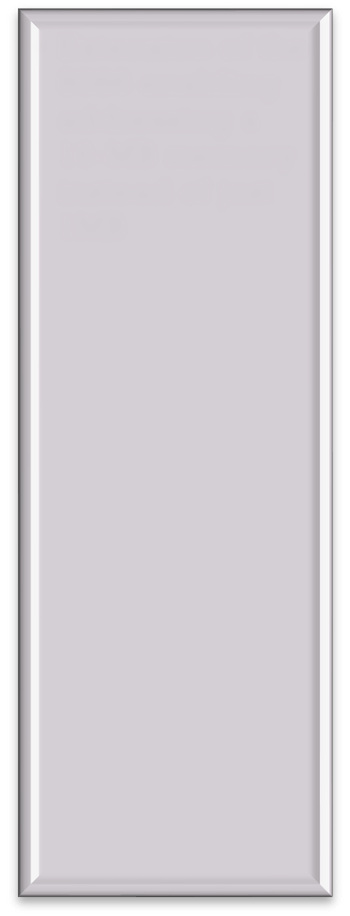


Highlights of the Evolution of the Intel Product Line:
8080
World’s first general-purpose microprocessor
8-bit machine, 8-bit data path to memory
Was used in the first personal computer (Altair)
8086
A more powerful 16-bit machine
Has an instruction cache, or queue, that prefetches a few instructions before they are executed
The first appearance of the x86 architecture
The 8088 was a variant of this processor and used in IBM’s first personal computer (securing the success of Intel
80286
Extension of the 8086 enabling addressing a
16-MB memory
instead of just 1MB
80386
Intel’s first 32-bit machine
First Intel processor to support multitasking
80486
Introduced the use of much more sophisticated and powerful cache technology and sophisticated instruction pipelining
Also offered a built-in math coprocessor

Slide 56
Highlights of the Evolution of the Intel Product Line:
Pentium
Intel introduced the use of superscalar techniques, which allow multiple instructions to execute in parallel
Pentium Pro
Continued the move into superscalar organization with aggressive use of register renaming, branch prediction, data flow analysis, and speculative execution
Pentium II
Incorporated Intel MMX technology, which is designed specifically to process video, audio, and graphics data efficiently
Pentium III
Incorporated additional floating-point instructions
Streaming SIMD Extensions (SSE)
Pentium 4
Includes additional floating-point and other enhancements for multimedia
Core
First Intel x86 micro-core
Core 2
Extends the Core architecture to 64 bits
Core 2 Quad provides four cores on a single chip
More recent Core offerings have up to 10 cores per chip
An important addition to the architecture was the Advanced Vector Extensions instruction set

Slide 57
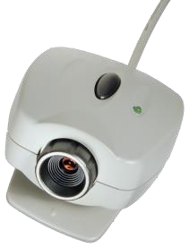
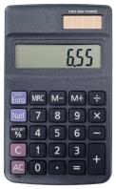
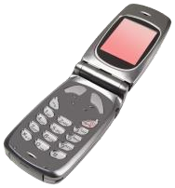
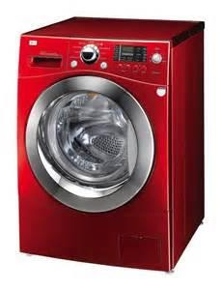
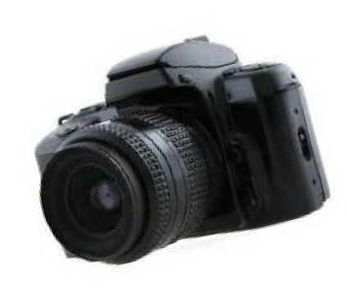
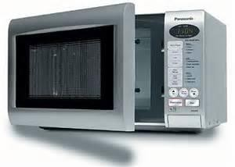
⁺ Embedded Systems
The use of electronics and software within a product
Billions of computer systems are produced each year that are embedded within larger devices
Today many devices that use electric power have an embedded computing system
Often embedded systems are tightly coupled to their
environment
  This can give rise to real-time constraints imposed by the need to interact with the environment
    Constraints such as required speeds of motion, required precision of measurement, and required time durations, dictate the timing of software operations
  If multiple activities must be managed simultaneously this imposes more complex real-time constraints

Slide 58

Custom logic
Processor
Memory
Human interface
Diagnostic port
A/D conversion
D/A Conversion
Sensors
Actuators/
indicators
Figure 1.14 Possible Organization of an Embedded System

Slide 59
⁺ The Internet of Things (IoT)
Term that refers to the expanding interconnection of smart devices, ranging from appliances to tiny sensors
Is primarily driven by deeply embedded devices
With reference to the end systems supported, the Internet has gone through roughly fourGenerations of deployment culminating in the IoT:
  Information technology (IT)
    PCs, servers, routers, firewalls, and so on, bought as IT devices by enterprise IT people and primarily using wired connectivity
  Operational technology (OT)
    Machines/appliances with embedded IT built by non-IT companies, such as medical machinery, SCADA, process control, and kiosks, bought as appliances by enterprise OT people and primarily using wired connectivity
  Personal technology
    Smartphones, tablets, and eBook readers bought as IT devices by consumers exclusively using wireless connectivity and often multiple forms of wireless connectivity
  Sensor/actuator technology
    Single-purpose devices bought by consumers, IT, and OT people exclusively using wireless connectivity, generally of a single form, as part of larger systems
It is the fourth generation that is usually thought of as the IoT and it is marked by the use of billions of embedded devices

Slide 60
Embedded Operating Systems
+
Application Processors
versus
Dedicated Processors
There are two general approaches to developing an embedded operating system (OS):
  Take an existing OS and adapt it for the embedded application
  Design and implement an OS intended solely for embedded use
Application processors
  Defined by the processor’s ability to execute complex operating systems, , such as Linux, Android, and Chrome
  Thus, the application processor id general-purpose in nature
  An example is the smartphone – the embedded system is designed to support numerous apps and perform a wide variety of functions
Dedicated processor
  Is dedicated to one or a small number of specific tasks required by the host device
  Because such an embedded system is dedicated to a specific task or tasks, the processor and associated components can be engineered to reduce size and cost

Slide 61






Processor
Analog data acquisition
A/D converter
RAM
Temporary data
Analog data transmission
D/A converter
ROM
Program and data
Send/receive
data
Serial I/O ports
EEPROM
Permanent data
Peripheral interfaces
Parallel I/O ports
TIMER
Timing functions
System bus
Figure 1.15 Typical Microcontroller Chip Elements
Microprocessor: Processor on a chip
Microcontroller is an entire computer on a chip, a microprocessor with on-chip memory and I/O.
Billions of microcontroller units are embedded each year in myriad products from toys to appliances to automobiles. For example, a single vehicle can use 70 or more microcontrollers.

Slide 62
⁺ Deeply Embedded Systems
Subset of embedded systems
Has a processor whose behavior is difficult to observe both by the programmer and the user
Uses a microcontroller rather than a microprocessor
Is not programmable once the program logic for the device has been burned into ROM
Has no interaction with a user
Dedicated, single-purpose devices that detect something in the environment, perform a basic level of processing, and then do something with the results
Often have wireless capability and appear in networked configurations, such as networks of sensors deployed over a large area
Typically have extreme resource constraints in terms of memory, processor size, time, and power consumption

Slide 63










ARM
Refers to a processor architecture that has evolved from RISC design principles and is used in embedded systems
Family of RISC-based microprocessors and microcontrollers designed by ARM Holdings, Cambridge, England
Chips are high-speed processors that are known for their small die size and low power requirements
Probably the most widely used embedded processor architecture and indeed the most widely used processor architecture of any kind in the world
Acorn RISC Machine/Advanced RISC Machine

Slide 64










ARM Products
+
Cortex-M
Cortex-M0
Cortex-M0+
Cortex-M3
Cortex-M4
Cortex-R
Cortex-A/Cortex-A50

Slide 65
⁺ The Cortex-A and Cortex-A50
The Cortex-A and Cortex-A50 are application processors, intended for mobile devices such as smartphones and eBook readers, as well as consumer devices such as digital TV and home gateways (e.g., DSL and cable Internet modems).
These processors run at higher clock frequency (over 1 GHz), and support a memory management unit (MMU), which is required for full feature OSs such as Linux, Android, MS Windows, and mobile OSs.
An MMU is a hardware module that supports virtual memory and paging by translating virtual addresses into physical addresses; this topic is explored in Chapter 8.
The two architectures use both the ARM and Thumb-2 instruction sets; the principal difference is that the Cortex-A is a 32-bit machine, and the Cortex-A50 is a 64-bit machine.

Slide 66
⁺ Cortex-R
The Cortex-R is designed to support real-time applications, in which the timing of events needs to be controlled with rapid response to events. They can run at a fairly high clock frequency (e.g., 200MHz to 800MHz) and have very low response latency.
The Cortex-R includes enhancements both to the instruction set and to the processor organization to support deeply embedded real-time devices.
Most of these processors do not have MMU; the limited data requirements and the limited number of simultaneous processes eliminates the need for elaborate hardware and software support for virtual memory.
The Cortex-R does have a Memory Protection Unit (MPU), cache, and other memory features designed for industrial applications. An MPU is a hardware module that prohibits one program in memory from accidentally accessing memory assigned to another active program. Using various methods, a protective boundary is created around the program, and instructions within the program are prohibited from referencing data outside of that boundary.
Examples of embedded systems that would use the Cortex-R are automotive braking systems, mass storage controllers, and networking and printing devices.

Slide 67
⁺ Cortex-M series
Cortex-M series processors have been developed primarily for the microcontroller domain where the need for fast, highly deterministic interrupt management is coupled with the desire for extremely low gate count and lowest possible power consumption. As with the Cortex-R series, the Cortex-M architecture has an MPU but no MMU. The market for the Cortex-M includes IoT devices, wireless sensor/actuator networks used in factories and other enterprises, automotive body electronics, and so on.
There are currently four versions of the Cortex-M series:
Cortex-M0 :
Designed for 8- and 16-bit applications, this model emphasizes low cost, ultra low power, and simplicity. It is optimized for small silicon die size (starting from 12k gates) and use in the lowest cost chips.
Cortex-M0+ :
An enhanced version of the M0 that is more energy efficient.
Cortex-M3 :
Designed for 16- and 32-bit applications, this model emphasizes performance and energy efficiency. It also has comprehensive debug and trace
features to enable software developers to develop their applications quickly.
Cortex-M4 :
This model provides all the features of the Cortex-M3, with additional instructions to support digital signal processing tasks.

Slide 68
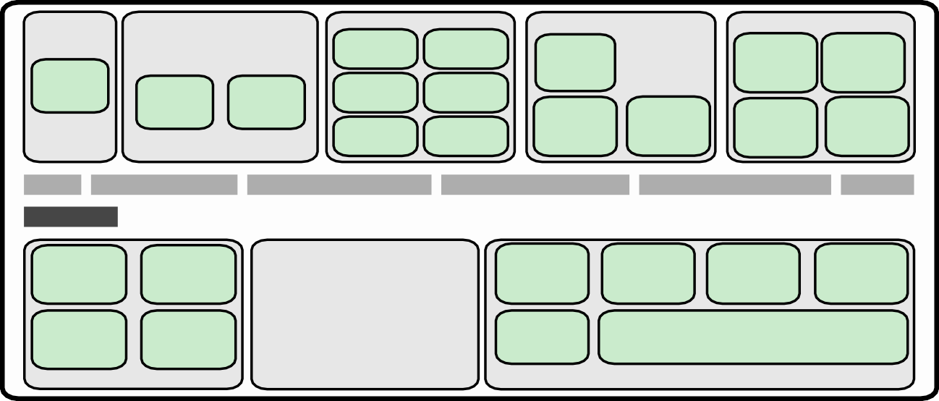

Security
Analog Interfaces
Timers &Triggers
Parallel I/O Ports
Serial Interfaces
USART USB
Periph bus int
Low energy
Pulse counter
Timer/ counter
Real time ctr
Watch-dog tmr
Pin reset
Hard-
ware | A/D | D/A
AES | con- | con-
 | verter | verter
General purpose I/O
External Inter-rupts
UART
Low-energy UART
Peripheral bus
32-bit bus
Voltage regula-tor
Voltage compar-ator
Brown-out de-tector
High fre-quency RC oscillator
High freq crystal oscillator
Flash memory 64 kB
Memory protec-tion unit
SRAM
memory 64 kB
Debug inter-face
DMA
control-ler
Power-on reset
Low fre-quency RC oscillator
Low freq crystal oscillator
Cortex-M3 processor
Energy management Clock management
Microcontroller Chip
Core and memory
ICode interface |  | SRAM & peripheral I/F
Bus matrix
Debug logic
DAP
Memory protection unit
NVIC
ARM
core
ETM
Cortex-M3 Core
NVIC
interface
ETM
interface
Cortex-M3 Processor
32-bit ALU
Hardware divider
32-bit multiplier
Control logic
Thumb decode
Instruction interface
Data interface
Figure 1.16 Typical Microcontroller Chip Based on Cortex-M3

Slide 69

⁺ Cloud Computing
NIST defines cloud computing as:
“A model for enabling ubiquitous, convenient, on-demand network access to a shared pool of configurable computing resources that can be rapidly provisioned and released with minimal
management effort or service provider interaction.”
You get economies of scale, professional network management, and professional security management
The individual or company only needs to pay for the storage
capacity and services they need
Cloud provider takes care of security

Slide 70
Cloud Networking
Refers to the networks and network management functionality that must
be in place to enable cloud computing
One example is the provisioning of high-performance and/or high-reliability networking between the provider and subscriber
The collection of network capabilities required to access a cloud, including making use of specialized services over the Internet, linking enterprise data center to a cloud, and using firewalls and other network security devices at critical points to enforce access security policies
Cloud Storage
Subset of cloud computing
Consists of database storage and database applications hosted remotely on cloud servers
Enables small businesses and individual users to take advantage of data storage that scales with their needs and to take advantage of a variety of database applications without having to buy, maintain, and manage the storage assets

Slide 71

























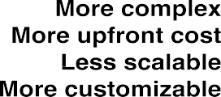
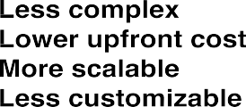


Slide 72
Summary
+
Basic Concepts and Computer Evolution
Chapter 1
Organization and architecture
Structure and function
Brief history of computers
  The First Generation: Vacuum tubes
  The Second Generation: Transistors
  The Third Generation: Integrated Circuits
  Later generations
The evolution of the Intel x86 architecture
Cloud computing
  Basic concepts
  Cloud services
Embedded systems
  The Internet of things
  Embedded operating systems
  Application processors versus dedicated processors
  Microprocessors versus
microcontrollers
  Embedded versus deeply embedded systems
ARM architecture
  ARM evolution
  Instruction set architecture
  ARM products

